Slide 1
Smart IoT-Based Low-Cost Fertilizer Advisory System Using Leaf Color and Soil-Environmental Sensing
19CSE339 – WIRELESS SENSOR NETWORKS
S.No | Reg.No | Name of the Student | Branch
1 | BL.EN.U4CSE22004 | A. Neeraja | CSE
2 | BL.EN.U4CSE22014 | Ch. Mounika Begum | CSE
3 | BL.EN.U4CSE22030 | K. Vigneswara Reddy | CSE
4 | BL.EN.U4CSE22231 | K Dhanush Reddy | CSE
Project Advisor: Ullas
Asst. Prof.( Sr.Gr. ) CSE Dept.

Slide 2
Introduction
Agriculture plays a vital role in the economy and food production.
Fertilizers are essential for crop growth, but improper usage leads to wastage and soil damage.
Farmers often apply fertilizers based on guesswork rather than data.
The proposed system uses IoT and sensors to monitor soil, crop, and environment in real-time.
Based on collected data, it gives smart fertilizer recommendations to farmers.

Slide 3
Problem Definition
Farmers often apply fertilizers manually without measuring soil or crop conditions, leading to overuse, soil degradation, and reduced yield. The absence of real-time monitoring and intelligent advisory systems makes it difficult to determine the right time and quantity for fertilizer application. This project addresses the need for a low-cost IoT-based solution that continuously monitors soil, leaf, and environmental parameters to provide timely and accurate fertilizer recommendations.

Slide 4
Objectives
To develop a low-cost IoT-based system for real-time soil and crop monitoring.
To use sensors for detecting nitrogen deficiency, soil moisture, temperature, and humidity.
To generate fertilizer advisory messages based on sensor readings.
To send data to cloud (ThingSpeak) for online visualization and alerting.
To assist farmers in making scientific and timely fertilizer decisions.

Slide 5
Literature Survey
S.No. | Authors name(s) | Full title of the paper with year | Inference from the paper | Open Problem (For proposed work)
1. | El-Tabakh et al. | Digital Agriculture for Enhancing Yield, Nutrition, and Biological Stress Resistance (2024) | Highlights how AI and computer vision improve crop yield, irrigation, and disease prediction through intelligent data analysis. | Focuses on high-cost AI systems; lacks low-cost, real-time IoT-based fertilizer advisory solutions for small farmers.
2. | Sangeetha & Pabboju | Design and Development of Automated IoT-Aided Smart Agriculture Management System for Efficient Crop Growth Using Hybrid Convolution (1D–2D)-Based Adaptive Residual Attention (2024) | Proposes an IoT-based AI model (H-ARAN) for plant disease detection, yield prediction, and smart irrigation with high accuracy. | Focuses on complex AI computation; lacks a simple, low-cost, real-time IoT system for fertilizer advisory based on field sensor data.
3. | Siva | Smart Fertilizer Recommendation through NPK Analysis Using Artificial Neural Networks (2019) | Uses ANN models to recommend fertilizers based on NPK soil nutrient analysis for improved crop growth accuracy. | Relies on laboratory-based NPK data and computational models; lacks integration with low-cost IoT sensors for on-field, real-time fertilizer advisory.

Slide 6
Literature Survey
S.No. | Authors name(s) | Full title of the paper with year | Inference from the paper | Open Problem (For proposed work)
4. | Diaz et al. | Low-Cost Optical Sensors for Soil Composition Monitoring (2024) | Develops a low-cost RGB-based optical sensor for detecting and classifying soil composition with high accuracy under different light conditions. | Focuses on soil classification but not on integrating soil and crop sensing for fertilizer advisory or real-time nutrient management using IoT.
5. | Carrasco et al. | Enhancing Leafy Greens’ Production: Nutrient Film Technique Systems and Automation in Container-Based Vertical Farming (2024) | Demonstrates how low-cost sensors and automation in NFT systems significantly boost leafy green yields while maintaining economic feasibility. | Focuses on controlled indoor environments; lacks integration of field-based IoT sensing and fertilizer advisory for open-field crop management.
6 | Patil | IOT DEVELOPMENT IN THE AGRICULTURE SECTOR (2023) | Reviews IoT technologies, sensors, and data systems used in smart farming, highlighting their role in improving efficiency and productivity. | rovides conceptual understanding but lacks practical low-cost implementations for real-time soil and fertilizer monitoring in small farms.

Slide 7
Literature Survey
S.No. | Authors name(s) | Full title of the paper with year | Inference from the paper | Open Problem (For proposed work)
7. | Doychev et al. | Architecture and Data Knowledge of the Regional Data Center for Intelligent Agriculture (2023) | Describes the design of a regional data center for smart farming, integrating sensor data and ontologies to support intelligent crop management. | Focuses on large-scale infrastructure; lacks lightweight, farm-level IoT systems for direct fertilizer advisory and localized soil-health monitoring.
8. | Xu et al. | Application of blockchain technology in food safety control：current trends and future prospects (2020) | Reviews how blockchain enhances food safety through transparent, tamper-proof data management across supply chains. | Focuses on post-harvest traceability; lacks integration of blockchain with IoT-based on-field sensing for nutrient management and fertilizer advisory.
9. | Bukhamsin et al. | Early and high-throughput plant diagnostics: strategies for disease detection (2025) | Reviews advanced sensing platforms and biomarkers for early plant disease detection and proposes integrated, cost-efficient diagnostic approaches. | Focuses on pathogen detection; lacks simple, IoT-based sensing frameworks for nutrient and fertilizer condition monitoring at the farm level.
10 | Lavanya et al. | An Automated Low-Cost IoT-Based Fertilizer Intimation System for Smart Agriculture (2020) | Proposes a colorimetric IoT system using an NPK sensor and fuzzy logic to provide fertilizer recommendations based on soil nutrient levels. | Focuses only on chemical nutrient detection; does not integrate environmental or leaf-color sensing for a holistic, real-time fertilizer advisory system.

Slide 8
Summary
Previous research in smart agriculture has implemented a variety of systems including AI-driven crop yield prediction, IoT-based plant disease detection, and RGB or NPK sensors for soil analysis. While these approaches improved specific aspects like disease monitoring or nutrient measurement, most relied on complex AI models, laboratory-based sensors, or high-cost infrastructure, making them unsuitable for small farms. Additionally, many studies focused on controlled environments or single-parameter sensing, lacking real-time integration of multiple field conditions. To address these limitations, the proposed system introduces a low-cost, multi-sensor IoT framework that simultaneously monitors leaf color, soil moisture, and environmental data, providing an automated and practical fertilizer advisory solution for open-field farming.

Slide 9
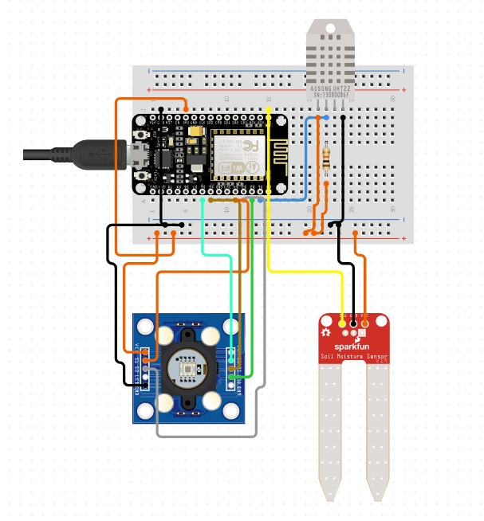
Circuit Diagram

Slide 10
Component Specifications
Component | Function
NodeMCU ESP8266 | Central controller, Wi-Fi connectivity
TCS3200 Sensor | Measures leaf color to assess nitrogen level
DHT11 Sensor | Monitors temperature and humidity
Soil Moisture Sensor | Determines soil water content
ThingSpeak Cloud | Cloud platform for data visualization
Twilio API | Sends SMS alerts to the farmer
Gmail SMTP | Sends detailed advisory emails

Slide 11
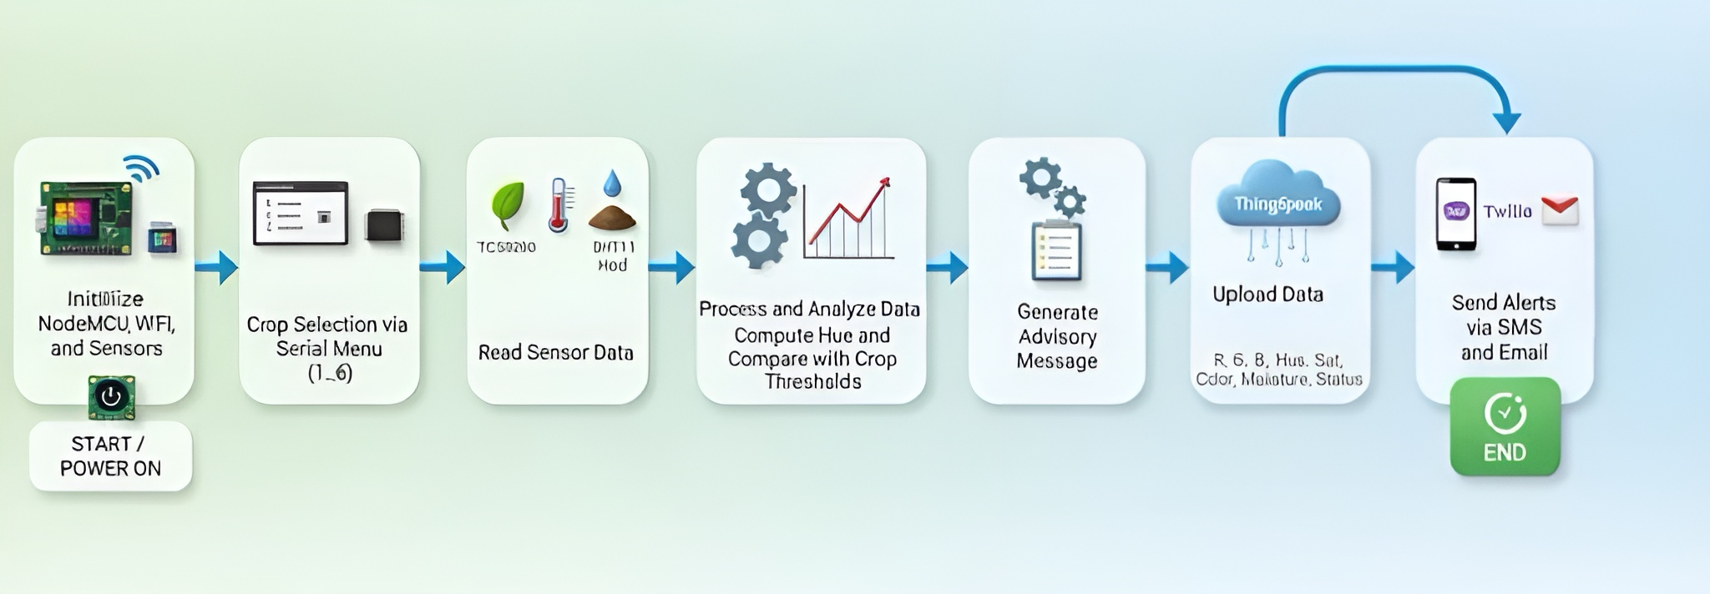
Flow Diagram

Slide 12
Working Principle
The system uses multiple sensors to collect real-time agricultural data:
Leaf color (TCS3200) → Nitrogen level
Soil moisture sensor → Water condition
DHT11 → Weather condition
The NodeMCU ESP8266 processes the data and compares it with preset crop-specific thresholds.
Based on the comparison, a fertilizer advisory message is generated.
The message is displayed, uploaded to ThingSpeak, and alerts are sent to the farmer via SMS (Twilio) and Email (Gmail SMTP) if action is required.
The process repeats automatically every 60 seconds for continuous monitoring.

Slide 13
Working Principle
Decision Logic:
Condition | Action
Low nitrogen + moist soil | Apply Urea now
Low nitrogen + dry soil | Irrigate first, then fertilize
High temperature or low humidity | Delay fertilizer application
Nitrogen sufficient | No fertilizer needed

Slide 14
Implementation
Hardware Setup:
The system is built around the NodeMCU ESP8266, which integrates Wi-Fi connectivity and acts as the control unit.
TCS3200 color sensor detects the leaf color to estimate the nitrogen content.
Soil moisture sensor measures soil water levels, and DHT11 sensor monitors ambient temperature and humidity.
All sensors are interfaced with the NodeMCU using analog and digital pins on a compact breadboard setup.
Power is supplied via a 5V adapter, ensuring stable operation in field environments.

Slide 15
Implementation
Software & Cloud Integration:
The microcontroller is programmed using Arduino IDE, with libraries for Wi-Fi, DHT, and ThingSpeak integration.
Sensor data is processed locally and sent to the ThingSpeak Cloud every 60 seconds for logging and graphical visualization.
Twilio API is used for sending SMS alerts, and Gmail SMTP handles email notifications to the farmer.
All logic (fertilizer decision, irrigation alert, weather stress detection) is embedded in the firmware for fully automated operation without manual input

Slide 16
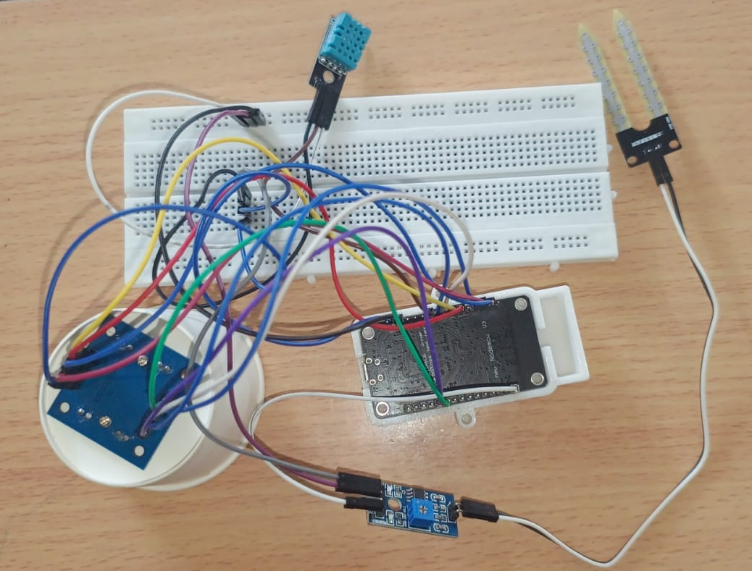
Results
Implemented hardware setup of the Smart Fertilizer Advisory System

Slide 17
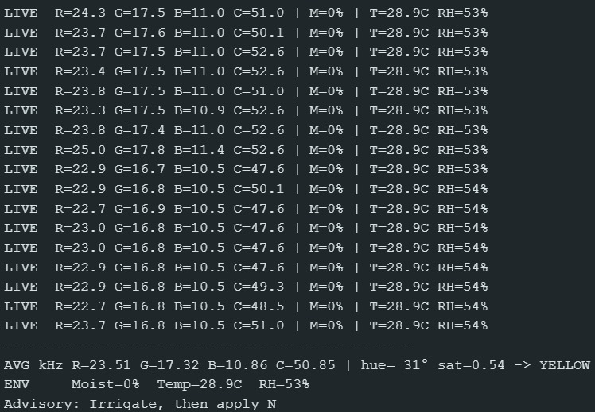
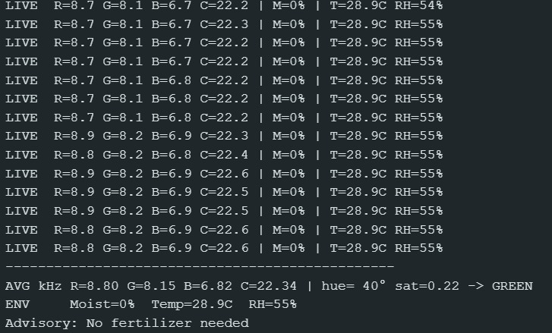
Results
Displayed Outputs

Slide 18
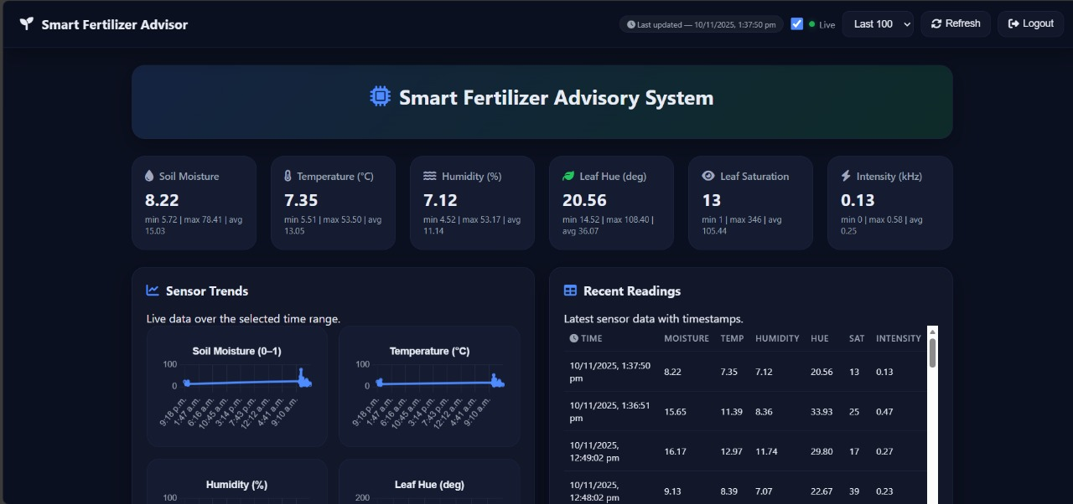
Results
User Interface of the Smart Fertilizer Advisory System

Slide 19
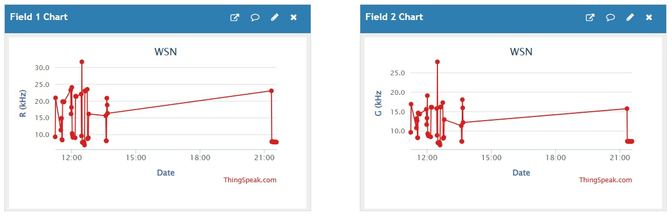
Results
Leaf color RGB variation

Slide 20
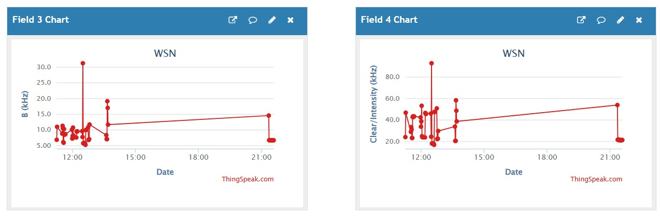
Results
Leaf color RGB variation

Slide 21
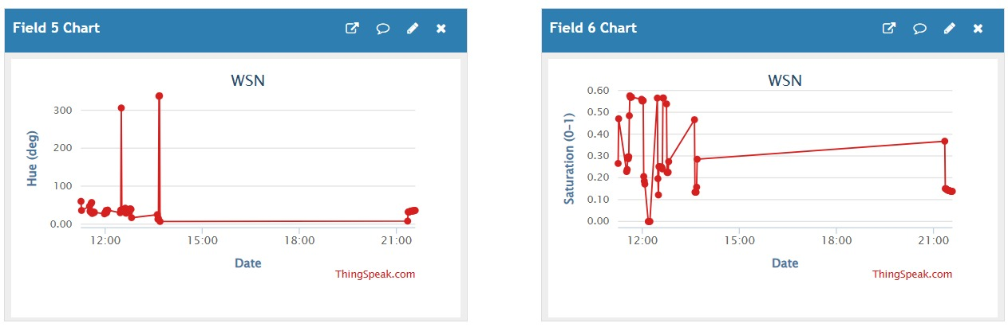
Results
Hue and saturation analysis

Slide 22
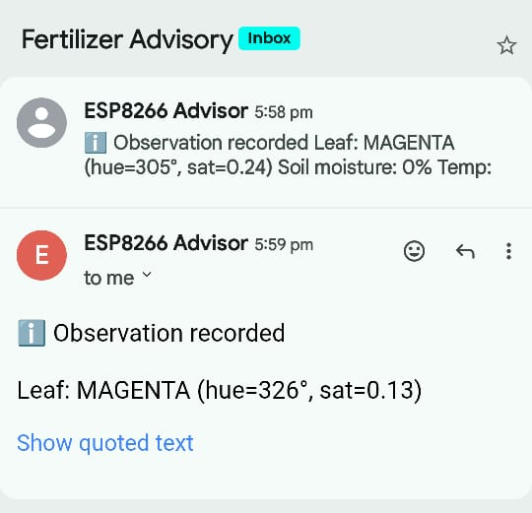
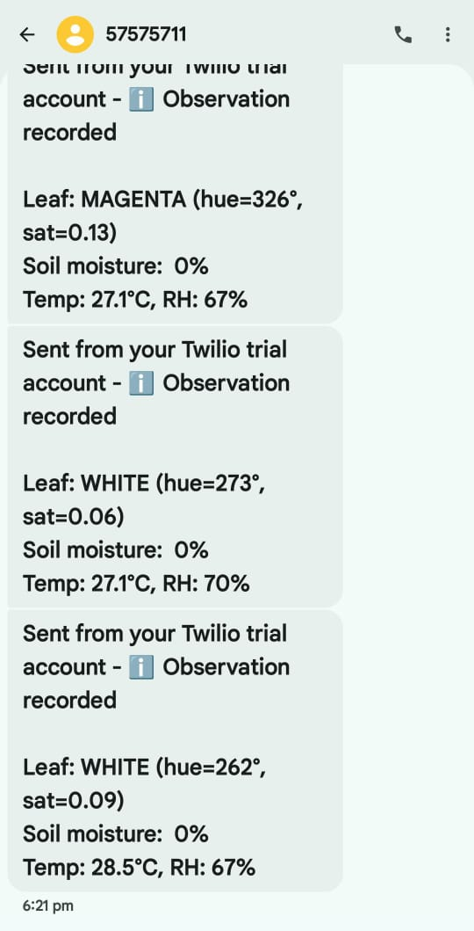
Results
Gmail and SMS Notifications

Slide 23
Conclusion
Developed a low-cost IoT-based fertilizer advisory system.
Real-time monitoring of soil, crop, and environmental conditions achieved.
System generates automatic fertilizer recommendations.
Helps in precision agriculture and sustainable farming.
Demonstrates how IoT technology can be effectively applied in agriculture.

Slide 24
Future Scope
Use of AI or machine learning for predictive fertilizer recommendation.
Integration of pH and NPK sensors for full nutrient analysis.
Solar-powered system for remote rural deployment.
Scalable multi-node network for large farms.

Slide 25
References
[1] El-Tabakh, Mohamed AM, Mariam A. Abd El-Samea, Yasmeen A. Roby, Yomna A. Mohamed, Hossam E. Harb, Ahmed M. Saleh, Mahmoud H. Abd El-Aziz, and Sozan E. El-Abeid. "Digital Agriculture for Enhancing Yield, Nutrition, and Biological Stress Resistance." In Digital Agriculture: A Solution for Sustainable Food and Nutritional Security, pp. 445-483. Cham: Springer International Publishing, 2024.
[2] Sangeetha, Bathini, and Suresh Pabboju. "Design and Development of Automated IoT-Aided Smart Agriculture Management System for Efficient Crop Growth Using Hybrid Convolution (1D–2D)-Based Adaptive Residual Attention." Sensing and Imaging 25, no. 1 (2024): 60.
[3] Siva, Faith. "Smart fertilizer recommendation through NPK analysis using Artificial Neural Networks." PhD diss., Strathmore University, 2019.
[4] Diaz, Francisco Javier, Ali Ahmad, Lorena Parra, Sandra Sendra, and Jaime Lloret. "Low-Cost Optical Sensors for Soil Composition Monitoring." Sensors 24, no. 4 (2024): 1140.
[5] Carrasco, Gilda, Fernando Fuentes-Peñailillo, Paula Manríquez, Pabla Rebolledo, Ricardo Vega, Karen Gutter, and Miguel Urrestarazu. "Enhancing leafy greens’ production: Nutrient film technique systems and automation in container-based vertical farming." Agronomy 14, no. 9 (2024): 1932.

Slide 26
References
[6] Patil, Ms Umeshwari. "IOT DEVELOPMENT IN THE AGRICULTURE SECTOR." The Online Journal of Distance Education and e-Learning 11, no. 1 (2023).
[7] Doychev, Emil, Atanas Terziyski, Stoyan Tenev, Asya Stoyanova-Doycheva, Vanya Ivanova, and Pepa Atanasova. "Architecture and Data Knowledge of the Regional Data Center for Intelligent Agriculture." Information 14, no. 4 (2023): 233.
[8] Xu, Yan, Xiangxin Li, Xiangquan Zeng, Jiankang Cao, and Weibo Jiang. "Application of blockchain technology in food safety control： current trends and future prospects." Critical reviews in food science and nutrition 62, no. 10 (2022): 2800-2819.
[9] Bukhamsin, Abdullah, Jürgen Kosel, Matthew F. Mccabe, Ikram Blilou, and Khaled N. Salama. "Early and high-throughput plant diagnostics: strategies for disease detection." Trends in plant science 30, no. 3 (2025): 324-337.
[10] Lavanya, G., Chellasamy Rani, and Pugalendhi GaneshKumar. "An automated low cost IoT based Fertilizer Intimation System for smart agriculture." Sustainable Computing: Informatics and Systems 28 (2020): 100300.

Slide 27
THANK YOU

